Slide 1
Natural Language Processing
School of infocomm

Slide 2
Need to know
Trainers
Ho Chee Wai (ho_chee_wai@rp.edu.sg)
Tan Poh Keam (tan_poh_keam@rp.edu.sg)
Assessment
Written assignment
Notes:
none

Slide 3
Learning Objectives
Describe the principles, concepts and usage of NLP
Perform text pre-processing activities
Discuss and use suitable methods for feature engineering of text
Discuss and use suitable approaches to analyze, classify and compare text
Explain how deep-learning techniques are used for text generation tasks
Consume Machine Learning services to build NLP applications
Use Azure Bot Services to build conversation systems
Notes:
Not to trainer:

Slide 4

Where We’re Heading
When | Topics
15 Jun | NLP Introduction Regular Expression Text Pre-processing
16 Jun | Features Engineering Document Classification (supervised learning)
17 Jun | Topic Modelling (unsupervised learning) Word Embedding
18 Jun | Topic Modelling (unsupervised learning) Text Generation
19 Jun | Google Language Services
When | Topics
22 Jun | Azure Bot Services Cognitive Services
23 Jun | Extra / extended classes (if needed)
25 Jun | Extra / extended classes (if needed)
Scope: Written, Development
Notes:
none

Slide 5
Introduction to NLP
School of infocomm

Slide 6
What is Natural Language Processing (NLP)
By “natural language” we mean a language that is used for everyday communication between humans.
Two main components:
Natural Language Understanding (NLU)
Natural Language Generation (NLG)
NLP is an intersection of several fields
Computer Science
Artificial Intelligence
Linguistics
NLP is AI-Complete
Requires all types of knowledge & context awareness humans possess → It is hard
Notes:
What is NLP? The process of using computers for extracting meaning from text. It can be any kind of computer manipulation of natural language. NLP could be as simple as calculating word frequencies; or more complex use-cases such as predictive text (autocomplete), handwriting recognition or grouping paragraphs into topics based on their content and context.
NLP is It is basically teaching computers to process human language
In the field of Artificial intelligence, the most difficult problems are informally know as AI complete.
An example of would be the task to translate accurately. To do this well, a machine must understand the text. It must be also able to follow the argument, so it must have some ability to reason. It also needs to know what the words mean, and how it is used in a certain context.

Slide 7
Ambiguity of Language
Synonymy – different words, same meaning
Polysemy – same word, different meaning , different usage
Text and speech are unstructured data
No fixed structure – Sentence format
No fixed schema – grammar
Sometimes dirty - Misspell, slang, abbreviations
Notes:
In the phrase “natural language processing”, the “natural language” can refer to either text or speech data. The process of converting either of these into concept space/computer-readable format is NLU. The process of going from the concept space back to either speech or text is natural language generation.
The entire process of switching from text to speech through concept space is text-to-speech while the entire process of switching from speech to text through concept space is speech-to-text.

Slide 8
History of NLP
NLP has been through (at least) 3 major eras:
1950s-1970s: Linguistics Methods and Rules
1980s-Now: Statistical + Machine Learning Methods
Now - ???: Deep Learning
You’re right near the start of a paradigm shift!
Notes:
Ref: https://www.dataversity.net/a-brief-history-of-natural-language-processing-nlp/

Slide 9
1950s - 1970s: Linguistics & Rules
Approach focused on:
Linguistics: Grammar rules, sentence structure parsing
Handwritten Rules: Huge sets of logical (if/else) statements
Phase structure grammar : conversion of sentences into forms that computers can understand
Problems:
Too complex to maintain
Cannot scale
Cannot generalize
I had fish for dinner
我晚餐吃鱼
Notes:
Early attempts at trying to understand languages relied heavily on if/else statements to encode every edge case you could think of. For example, while most words can be converted to past tense by adding ‘ed’ (eg. kick -> kicked), some words don’t follow this pattern (eg. run -> ran). The problems with this are apparent, nobody has the time to hard code every rule, so these systems can’t scale or generalize.

Slide 10
1980s - Now: Statistical / Machine Learning Methods
Approach shifted from linguistics to data-driven
Increasing computational power and ease to access of text
First web page (1991) → discussion forums, blogs, news portal
Digital archives
NLP starts using statistical and probabilistic models
Data mining → text mining
Generic machine learning algorithms applied to NLP tasks
Sentiment analysis using logistic regression
Language models with Markov models
Notes:
In the 80s, NLP approaches grew from using linguistic and handwritten rules to creating easily generalizable statistical models from the analysis of a text corpora
Text mining – just focus on the text and NLP deals with the undelying features / semantivcs
Text mining is about extracting useful information from the available data.
Information could be patterns in text or matching structure but the semantics in the text is not considered.
The goal is not about making the system understand what does the text conveys, rather about providing information to the user based on a certain step by step process.
speech recognition systems could be a part of NLP, but it has nothing to do with text mining.

Slide 11
Now and future: Deep Learning
More advances in computing power with parallelization (GPU)
Availability of large datasets becomes the norm
Neural Network
Learnt word representation with finite dimensions
Capture semantic and relationships among words
RNN / LSTM
Allows sequential processing and learning of text
Application into machine translation tasks and questions/answering systems
Attention-based model
A way to place various degree of focus (attention) on different part of the text
Break-through in machine translation and text generation tasks
Notes:
Leading point:
Deep Learning is a subset of Machine Learning algorithms that use a large (LARGE) amount of data to recognize patterns and utilize neural networks.
Breakthrough source: https://beamandrew.github.io/deeplearning/2017/02/23/deep_learning_101_part1.html
Last bullet?

Slide 12
NLP: Speech vs Text
Data source can refer to written text or speech
Goal of both is the same: translate raw data (text or speech) into underlying concepts (NLU) then possibly into the other form (NLG)
Text to Speech
NLU
NLU
Text
Concept Space
Speech
NLG
NLG
Speech to Text
Notes:
In the phrase “natural language processing”, the “natural language” can refer to either text or speech data. The process of converting either of these into concept space/computer-readable format is NLU. The process of going from the concept space back to either speech or text is natural language generation.
The entire process of switching from text to speech through concept space is text-to-speech while the entire process of switching from speech to text through concept space is speech-to-text.

Slide 13
NLU Applications
Classification
Natural Language Search
Document Recommendation
Topic Modeling
Language Identification
Intent matching for dialog systems
Notes:
Classification – for example, given a product review, how is the consumer really feeling?
Natural language search is searched carried out in every language, phrasing questions as you would ask them if you are talking to a person. Foe example Smart Speakrs

Slide 14
NLU Application: Document Classification
Classify documents (discrete collections of text) - into categories
Classify emails as spam vs not spam
Classify product reviews as positive vs negative
Assign labels to documents
Notes:
Here’s a cool post by Google Cloud on Document Classification: https://cloud.google.com/blog/big-data/2018/01/problem-solving-with-ml-automatic-document-classification

Slide 15
NLU Application: Document Recommendation
Choosing the most relevant document based on some information or "finger print":
Show most relevant webpages based on query to search engine
Recommend news articles based on past articles liked or read
Recommend restaurants based on restaurant reviews
Notes:
Cool implementation of document recommendation for movies: https://www.kernix.com/blog/recommender-system-based-on-natural-language-processing_p10
Bookmark this link! You’ll find it a lot easier to understand after the course.
https://sites.northwestern.edu/msia/2018/03/16/movie-recommender-system-based-on-natural-language-processing/

Slide 16
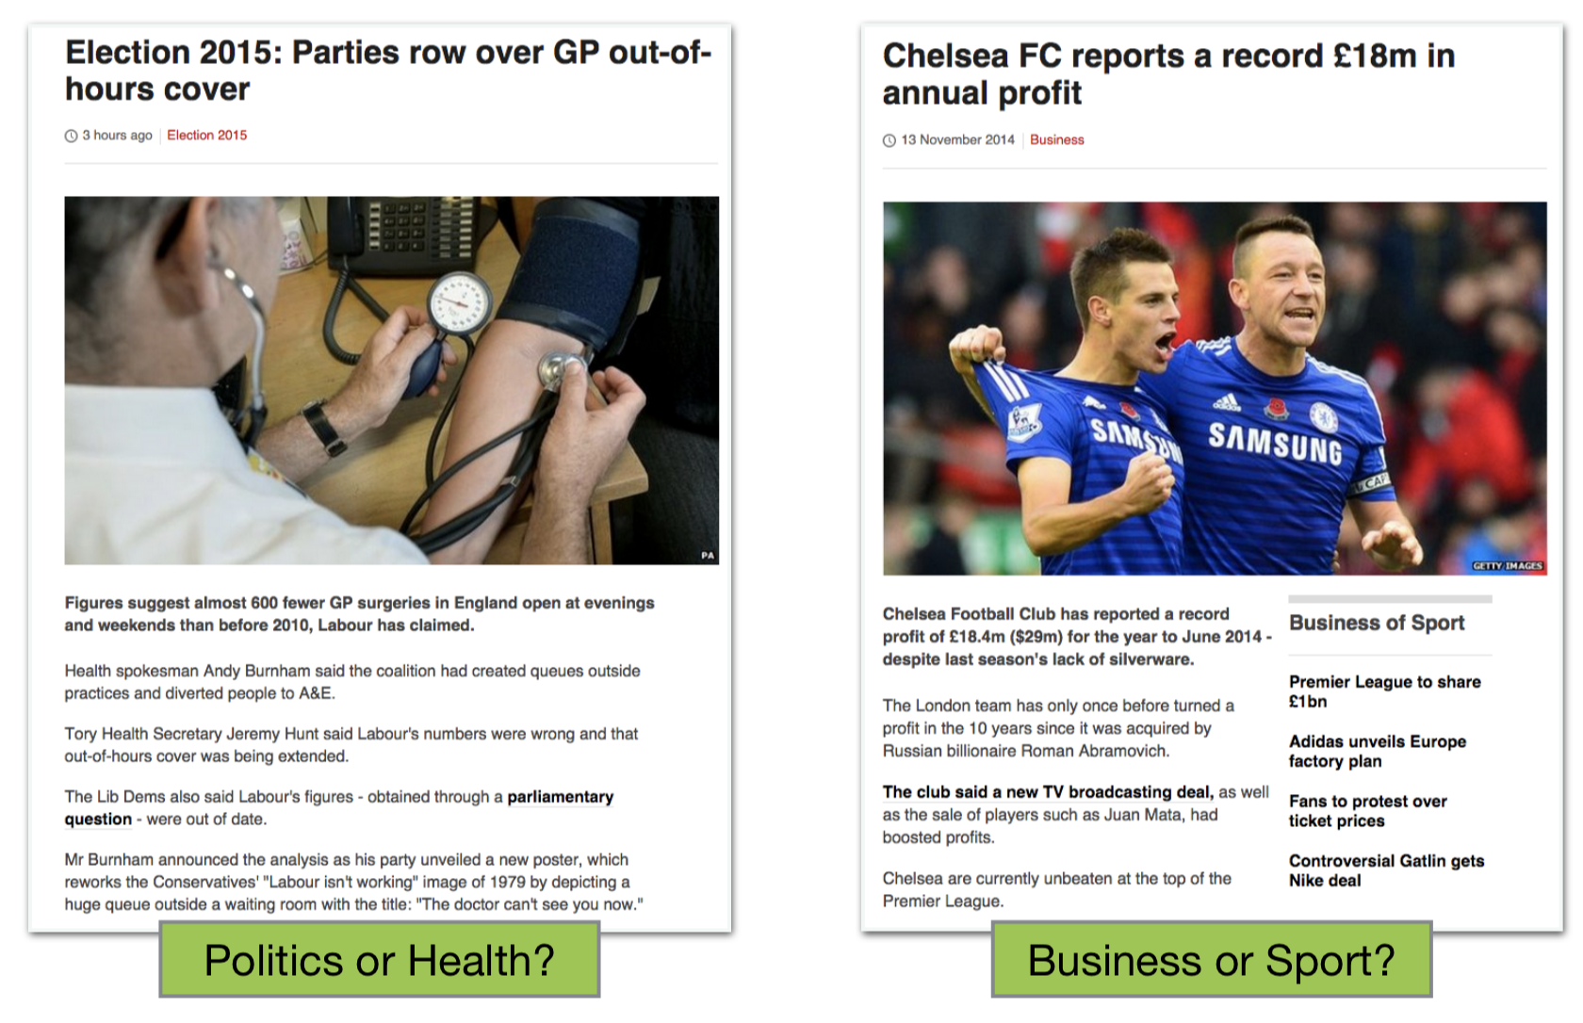
NLU Application: Topic Modeling
Breaking a set of documents into topics at the word level
See how prevalence of certain topics covered in a magazine changes over time
Find documents belonging to a certain topic
Notes:
Every document we read can be thought of as consisting of many topics all stacked upon one another.
So topic modelling tries to find the different topics
We can unpack these topics using NLP techniques.
We will be learning more about this topic later in the course!

Slide 17
NLU Application: Intent Matching
Understanding that there are many ways to say or ask for the same thing
Use in dialog systems
May I know the opening time for the store?
Can I come to shop now?
What time do you close?
Is the mall still open?
I can come at 8 pm, is it okay ?
Notes:
Every document we read can be thought of as consisting of many topics all stacked upon one another.
So topic modelling tries to find the different topics
We can unpack these topics using NLP techniques.
We will be learning more about this topic later in the course!

Slide 18
NLG
Applications
Machine Translation
Document Summarization
Text Generation
Question Answering
Image Captioning
Notice NLU is almost a prerequisite for NLG
Notes:
Document summarization is the task of creating a short meaningful description of a larger documentation

Slide 19
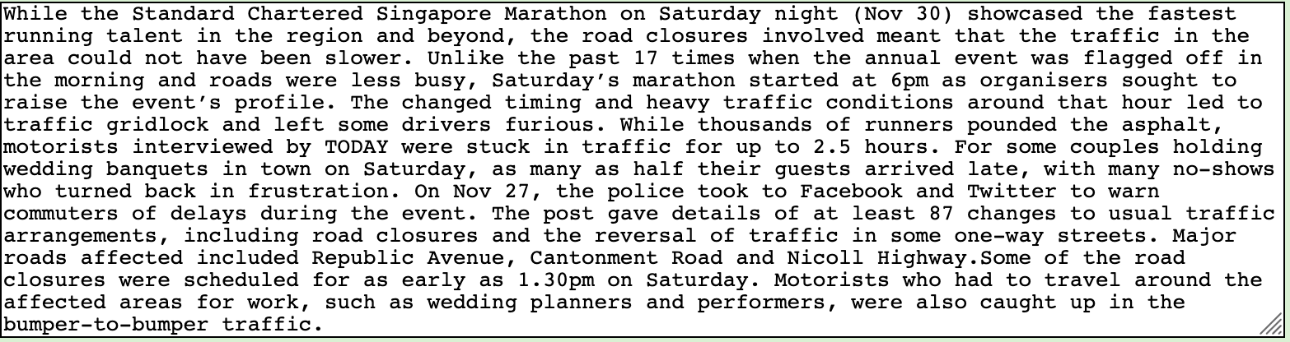
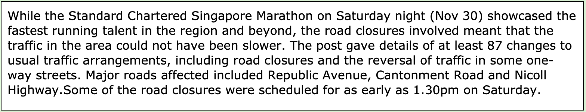
NLG Application: Document Summarization
Read less
Keep 30% of text
Demo: https://www.textcompactor.com/
Notes:
Text summarization refers to the technique of shortening long pieces of text. The intention is to create a coherent and fluent summary having only the main points outlined in the document. Automatic text summarization is a common problem in machine learning and natural language processing (NLP).Sep
This example Extractive Methods: These methods rely on extracting several parts, such as phrases and sentences, from a piece of text and stack them together to create a summary.
Most summarization approaches today are extractive in nature

Slide 20
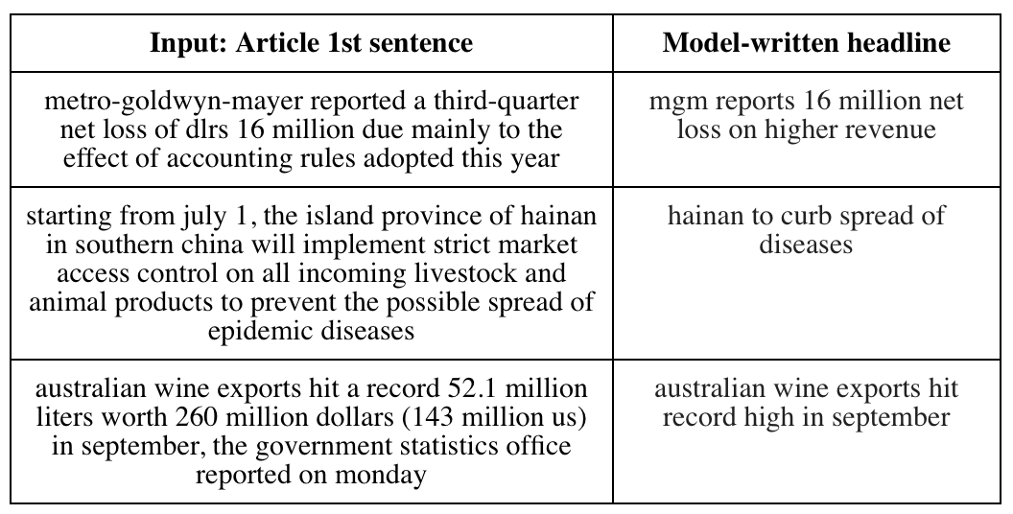
NLG Application: Document Summarization
Automatically generate text summaries of documents
Source: https://ai.googleblog.com/2016/08/text-summarization-with-tensorflow.html
Notes:
Google developed this text summarization using TensorFlow and so far has had success in generating sensible headlines from the first few sentences of an article, but the method currently performs more poorly on longer texts.
Abstractive Methods: These methods use advanced NLP techniques to generate an entirely new summary consisting of its own phrases and sentences to offer a more coherent summary, like what a human would generate. This approach is a more appealing, but much more difficult than extractive summarization. A. Encoder-Decoder Model (TextSum) B. Sequence-to-Sequence RNNs

Slide 21
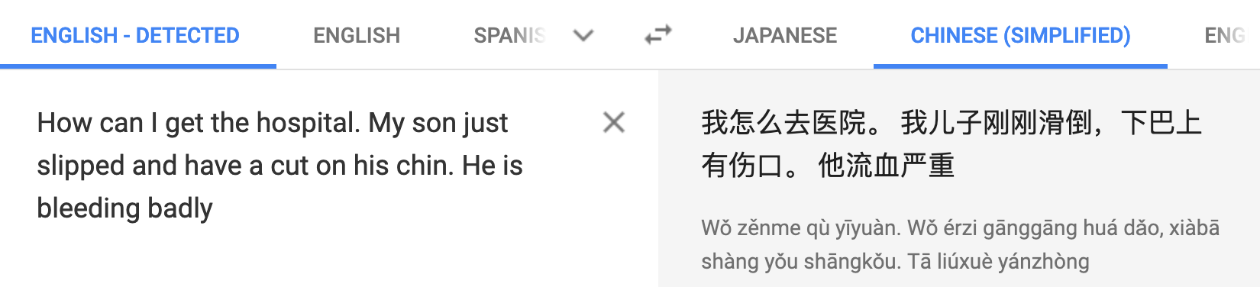

NLG Application: Machine Translation
Automatically translate text between languages
Example from Google Translate
Reading : https://ai.googleblog.com/2016/09/a-neural-network-for-machine.html
Notes:
PBMT: Phrase Based Machine Translation. It breaks up the inputs into words and phrases which are each translated individually.
GNMT: Google Neural Machine Translation. State of the art method developed by Google that considers a sentence as a whole. Currently being used to translate Chinese to English on Google Translate.
As you can see the GNMT definitely outperforms the PBMT in terms of readability and I might argue that it even beats the human translation.

Slide 22
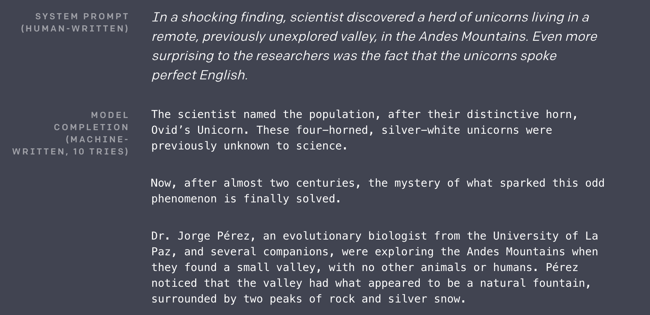
NLG Application: Text Generation
Source: https://openai.com/blog/better-language-models/
Notes:
Google developed this text summarization using TensorFlow and so far has had success in generating sensible headlines from the first few sentences of an article, but the method currently performs more poorly on longer texts.

Slide 23
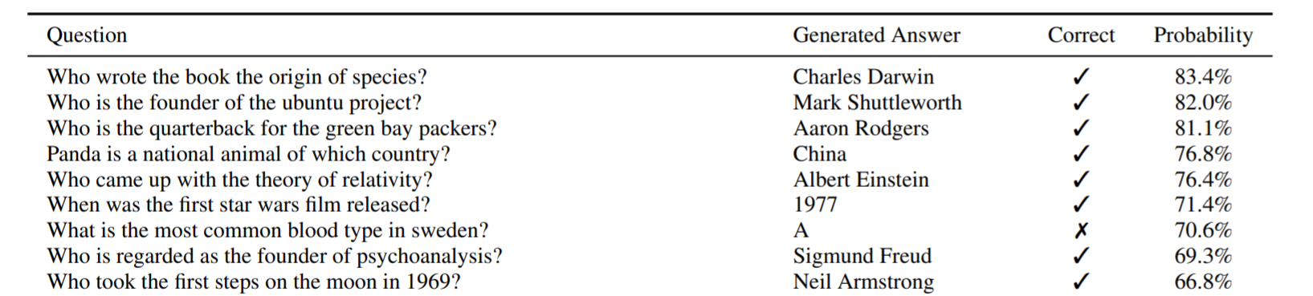
NLG Application: Question and Answering
QnA is concerned with building unsupervised models/systems that provides answer to questions based on large and diverse text sources
Most confident answers generated by GPT-2 on the development set of Natural Questions
Source: https://d4mucfpksywv.cloudfront.net/better-language-models/language_models_are_unsupervised_multitask_learners.pdf
Notes:
Google developed this text summarization using TensorFlow and so far has had success in generating sensible headlines from the first few sentences of an article, but the method currently performs more poorly on longer texts.

Slide 24
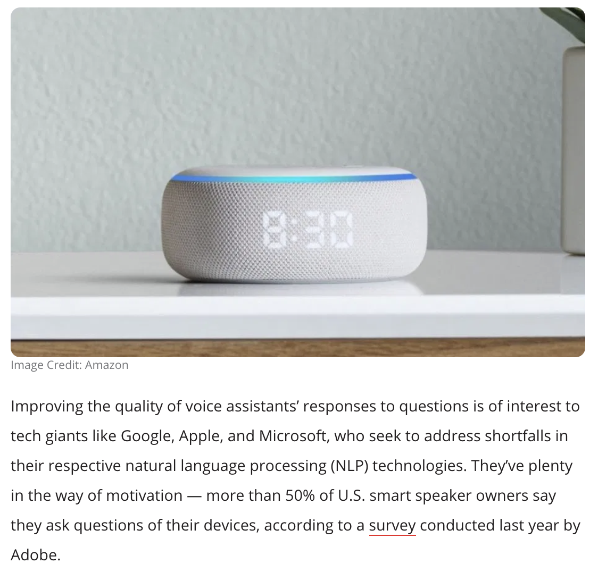
NLG Application: Question Answering
Source: https://venturebeat.com/2019/11/25/amazon-researchers-use-nlp-data-set-to-improve-alexas-answers/

Slide 25
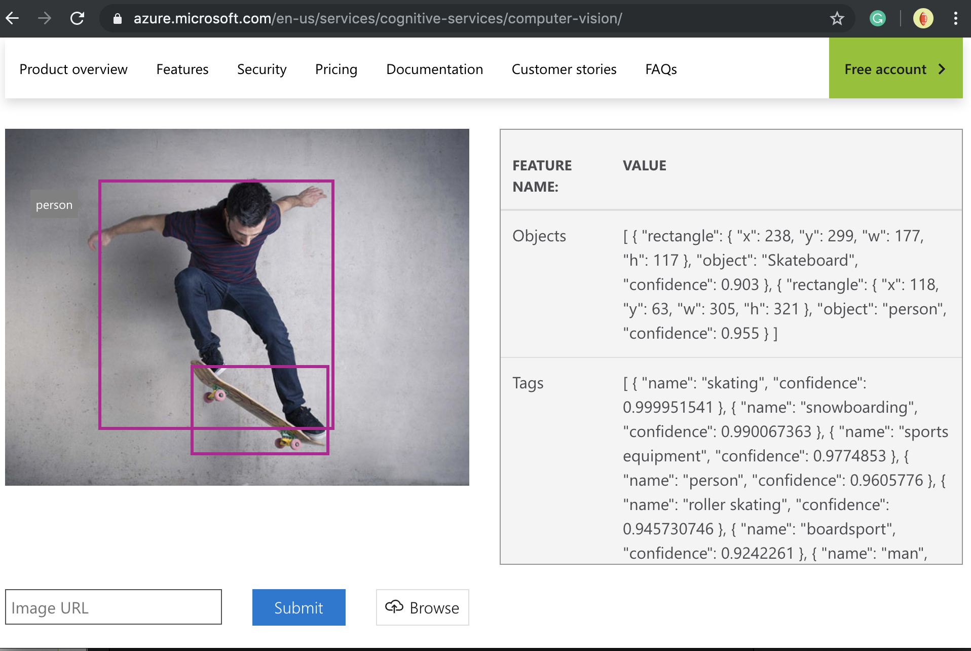
NLG Application: Image Captioning
Demo:
https://azure.microsoft.com/en-us/services/cognitive-services/computer-vision/
Notes:
As you can see the algorithms generally perform pretty well and even sound human like. However, the picture on the right seems to be mislabeled. The algorithm probably thought that the water in the background meant that the boy was wakeboarding.

Slide 26
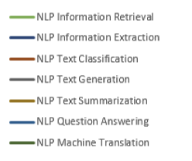
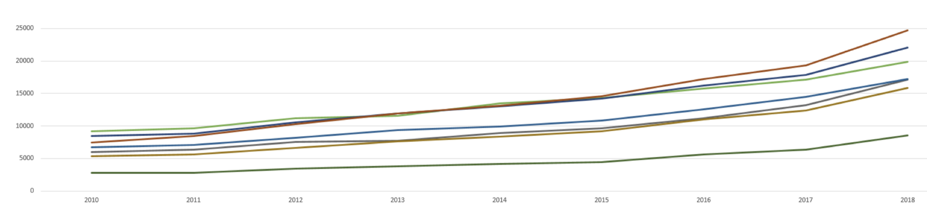
Publications on Applied Areas of NLP
#4: QnA
#1: Classification
#2: Extraction
#3: Retrieval
A Survey of the Usages of Deep Learning for Natural Language Processing , Daniel W. Otter, Julian R. Medina, and Jugal K. Kalita
(https://arxiv.org/pdf/1807.10854.pdf)
Notes:
Information retrieval is based on a query - you specify what information you need and it is returned in human understandable form.
Information extraction is about structuring unstructured information - given some sources all of the (relevant) information is structured in a form that will be easy for processing. This will not necessary be in human understandable form - it can be only for use of computer programs.

Slide 27
NLP Search Benchmarks
BLEU Score - BiLingual Evaluation Understudy
- Metric to evaluate translations from one language to another
SQuAD — Stanford Question Answering Dataset
- Dataset of text and related questions with answers from the dataset. Given a question and the model needs to predict the right answer
MS MACRO — MAchine Reading COmprehension Dataset
- Large scale dataset focused on machine reading comprehension
GLUE - General Language Understanding Evaluation
- Evaluates the performance of a model on a collection of multiple NLP tasks
Source: https://d4mucfpksywv.cloudfront.net/better-language-models/language_models_are_unsupervised_multitask_learners.pdf
Notes:
Google developed this text summarization using TensorFlow and so far has had success in generating sensible headlines from the first few sentences of an article, but the method currently performs more poorly on longer texts.

Slide 28
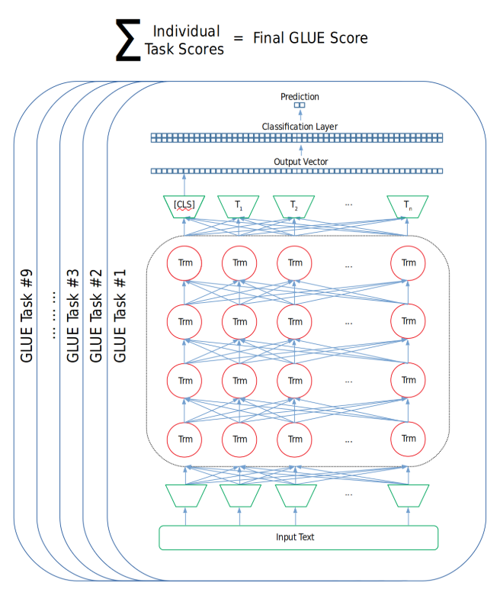
GLUE
A collection of resources for training, evaluating, and analysing natural language understanding systems
Language understanding tasks built on established existing datasets and selected to cover a diverse range of dataset sizes, text genres, and degrees of difficulty
Website contains a leader board for tracking performance of emerging models / algorithms against benchmark (https://gluebenchmark.com/leaderboard)
Credit: https://mccormickml.com/2019/11/05/GLUE/
Notes:
Deep Learning is a subset of Machine Learning algorithms that use a large (LARGE) amount of data to recognize patterns and utilize neural networks.
Breakthrough source: https://beamandrew.github.io/deeplearning/2017/02/23/deep_learning_101_part1.html
Last bullet?

Slide 29
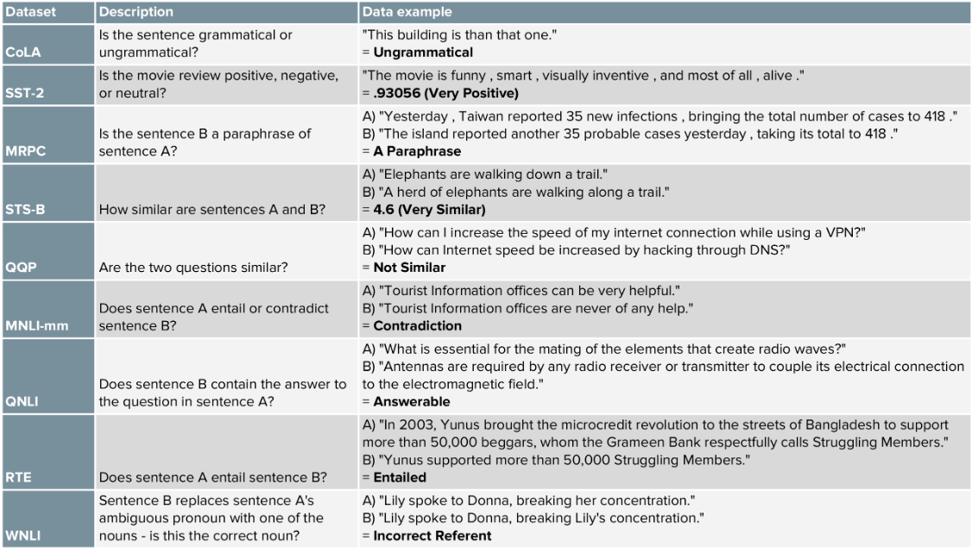
Credit: https://mccormickml.com/2019/11/05/GLUE/
Notes:
Deep Learning is a subset of Machine Learning algorithms that use a large (LARGE) amount of data to recognize patterns and utilize neural networks.
Breakthrough source: https://beamandrew.github.io/deeplearning/2017/02/23/deep_learning_101_part1.html
Last bullet?

Slide 30
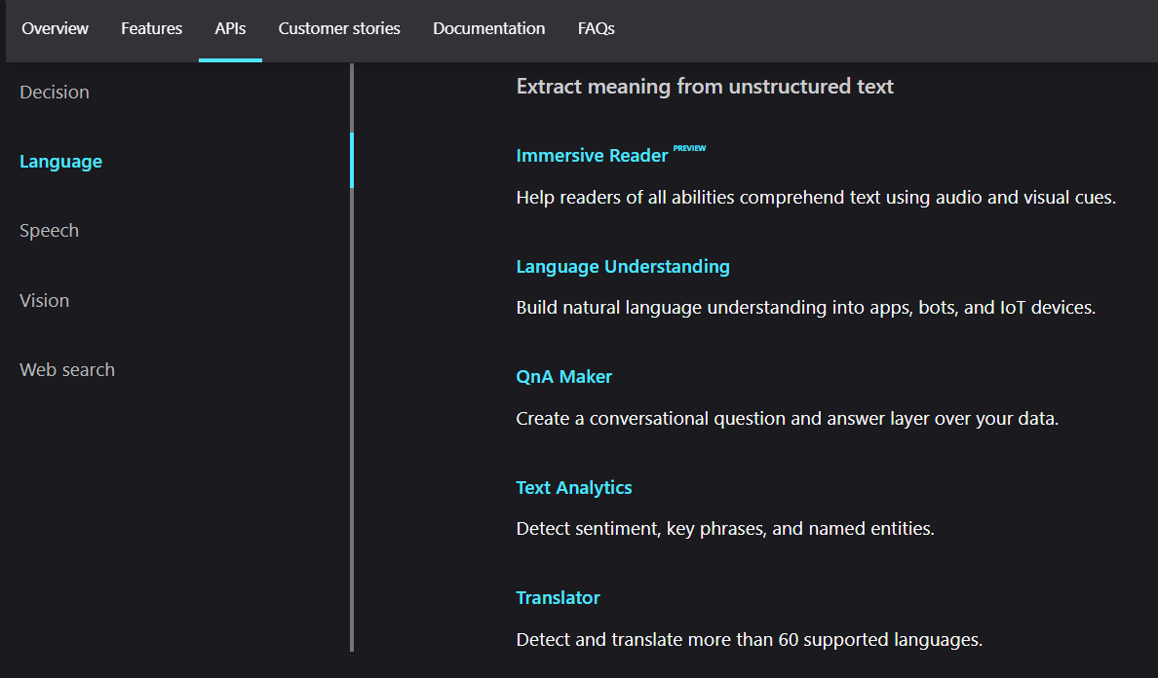
Cognitive Language Services for Building Apps
Notes:
Deep Learning is a subset of Machine Learning algorithms that use a large (LARGE) amount of data to recognize patterns and utilize neural networks.
Breakthrough source: https://beamandrew.github.io/deeplearning/2017/02/23/deep_learning_101_part1.html
Last bullet?

Slide 31
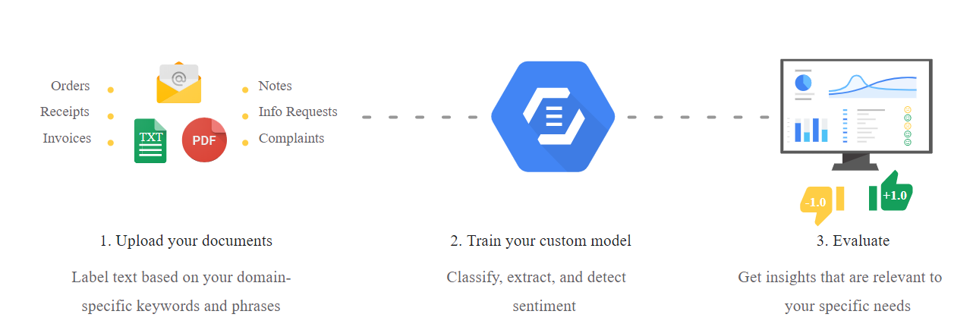
Language Services for Building Apps
Google

Slide 32
Key Takeaways
There are many NLP enabled applications around us
It is hard to understand language, but technology leaders and the research community are discovering better ways to create better algorithms and models to perform NLP tasks
You can create models or consume language API or services
Notes:
nformation retrieval is based on a query - you specify what information you need and it is returned in human understandable form.
Information extraction is about structuring unstructured information - given some sources all of the (relevant) information is structured in a form that will be easy for processing. This will not necessary be in human understandable form - it can be only for use of computer programs.

